Slide 1

LiDAR-based Canopy Cover prediction
June 28th Update
Alejandro Donaire Èric Sánchez Pau Ventura

Slide 2
Long time no see…
Code review
Roadmap
Task assignment

Slide 3
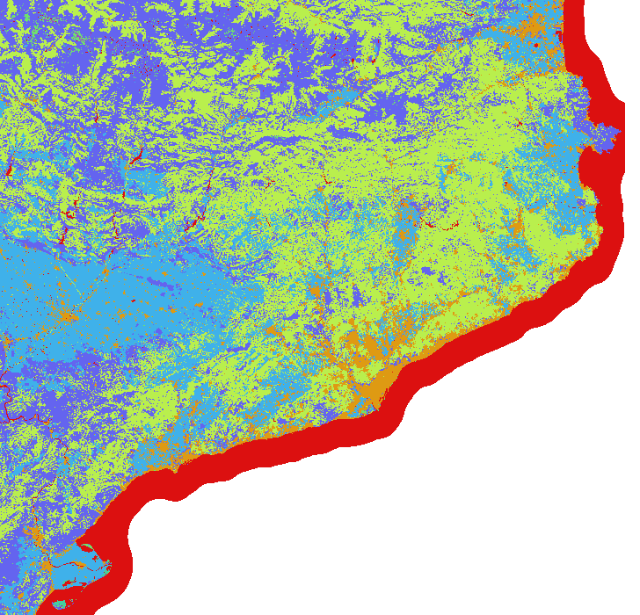

LandUse update

Slide 4

LandUse update

Slide 5
LandUse update

Slide 6

Pixel coordinate reference point in GeoTIFF files
Can be generalized using GeoTIFF files metadata

Slide 7
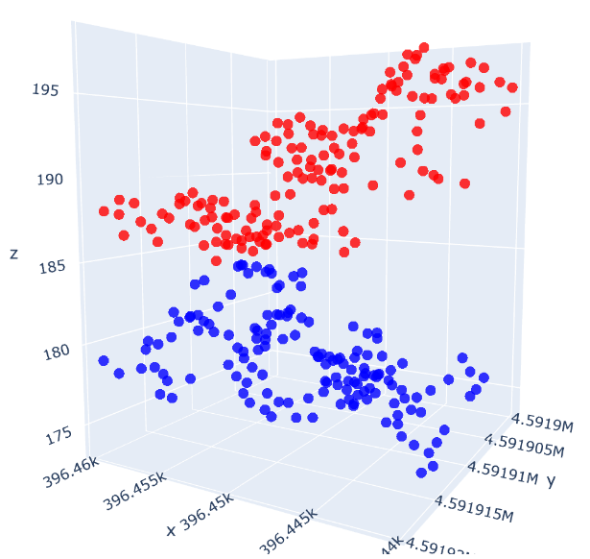
New feature: number of tree tops
Alternative to K-Means (too complex computationally)
“Vertical scan” to locate tops
The model will learn that a greater amount of tree tops will produce more coverage
Can be used as cluster center for further analysis

Slide 8
Next week
Fix GeoTIFF pixel reference error
Prepare Python scripts for execution in cluster
Finish tree-tops algorithm
Solve other technical issues and get ready to execution in cluster

